Slide 1
What are we going to learn?

Slide 2
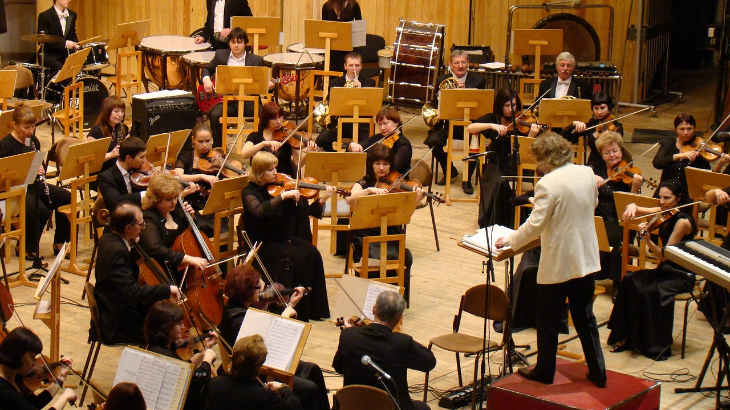
Photo credits: https://pixabay.com/it/

