Slide 1
The renaissance
Professor Chiara Villani

Slide 2
Modul structure
Unit 1
FROM FLORENCE TO FLORENCE
A DEFINITION
Unit 2
WHAT IS NEW IN ARCHITECTURE
WHAT IS NEW IN PAINT
Unit3
EARLY RENAISSANCE'S STARS
HIGHT RENAISSANCE'S STARS
Unit 4
ARCHITECTURE
Unit5
SCULPTURE
Unit7
PAINT
Unit 8
A UNIQUE STAR
Unit 9
SUM UP
Unit 10
TESTING
Professor Chiara Villani

Slide 3
SUPPORT MATERIALS (scaffolding)
Mind map, sum up table, DICTIONARY, flashcards
Professor Chiara Villani

Slide 4
MIND MAP
https://drive.google.com/file/d/1WZYT2oqInjtJbNibwEAr5PF8GMIqFcLv/view?usp=sharing
Professor Chiara Villani

Slide 5
SUM UP TABLE
https://docs.google.com/spreadsheets/d/133-Vr_gI0mFuXPqtCYinLTO4Kw9Iy9mt6d7RXl_ZMZg/edit?usp=sharing
Professor Chiara Villani

Slide 6
DICTIONARY
https://docs.google.com/document/d/1P9PzDKFgvM2Vmh6g4dRs11zX2BJzClPhj-QYniDpZDc/edit?usp=sharing
Professor Chiara Villani

Slide 7
FLASH CARDS
https://quizlet.com/13380046/renaissance-art-final-

Slide 8
UNIT 1
Educational sheets and video
Professor Chiara Villani

Slide 9
ACTIVITIES
MATCH
TEXT
Professor Chiara Villani

Slide 10
DEFINITION
The term Renaissance, adopted from the French equivalent of the Italian word rinascita, meaning literally "rebirth," describes the radical and comprehensive changes that took place in European culture during the 15th and 16th centuries.The term Renaissance originally referred to the revival of the values and artistic styles of classical antiquity during that period, especially in Italy.
By the 15th century intensive study of the Greek as well as Latin classics, ancient art and archaeology, and classical history, had given Renaissance scholars a more sophisticated view of antiquity. The culture of Renaissance Italy was distinguished by many highly competitive and advanced urban areas.The chief patrons of Renaissance art and literature were the merchant classes of Florence and Venice, which created in the Renaissance palace their own distinctive home and workplace.
Professor Chiara Villani

Slide 11
UNIT 2
Educational sheets
Professor Chiara Villani

Slide 12
WHAT IS NEW IN ARCHITECTURE
CITY
PALACE
STUDIOLO
Professor Chiara Villani

Slide 13
WHAT IS NEW IN PAINTING
ALTARPIECE
OIL PAINTING
PORTRAIT
🎨
Professor Chiara Villani

Slide 14
UNIT 3
Educational sheets and video
Professor Chiara Villani

Slide 15
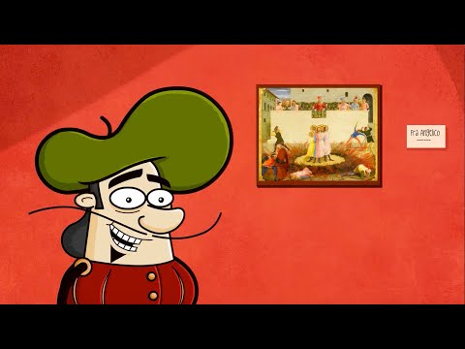
SIMPLE
Professor Chiara Villani

Slide 16
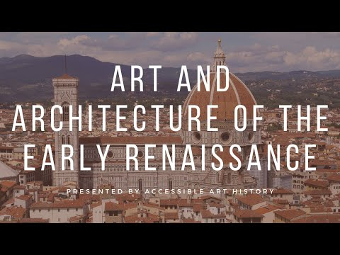
EARLY RENAISSANCE
Video 1
Professor Chiara Villani

Slide 17
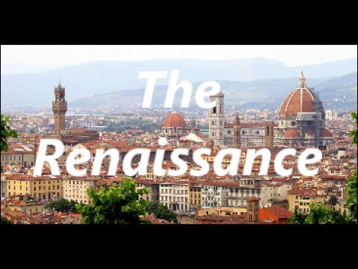
EARLY RENAISSANCE
Video 2
Professor Chiara Villani

Slide 18
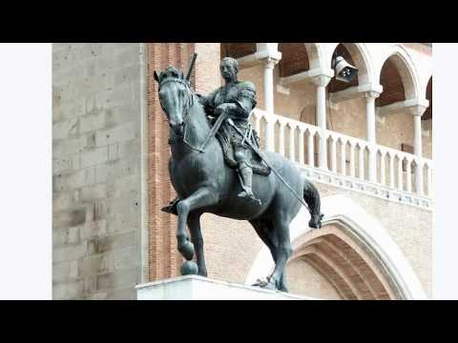
EARLY RENAISSANCE
Video 3
Professor Chiara Villani

Slide 19
EDUCATIONAL SHEET
TABLE
TEXT
Professor Chiara Villani

Slide 20
high RENAISSANCE
Video 1
Professor Chiara Villani

Slide 21
high RENAISSANCE
Video 2
Video 3
Professor Chiara Villani

Slide 22
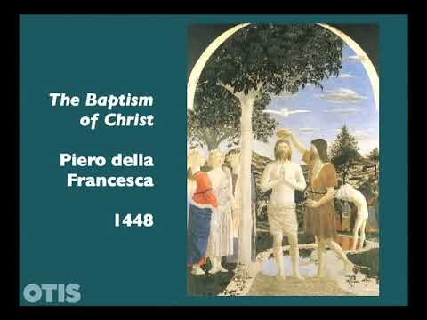
high RENAISSANCE
Video 3
Professor Chiara Villani

Slide 23
EDUCATIONAL SHEET
TABLE
TEXT

Slide 24
UNIT 4
Educational sheets and video
Professor Chiara Villani

Slide 25
EDUCATIONAL SHEETS
Brunelleschi
BIOGRAPHY
WORKS
GAME
Professor Chiara Villani

Slide 26
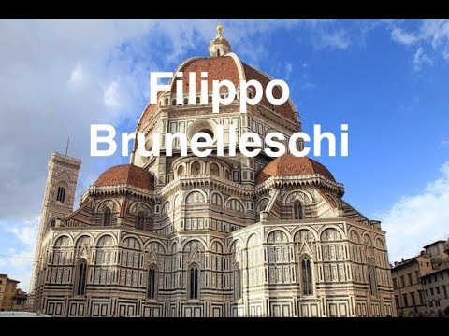
to revise at home
Professor Chiara Villani

Slide 27
EDUCATIONAL SHEETS
Bramante
BIOGRAPHY
WORKS
GAME
Professor Chiara Villani

Slide 28
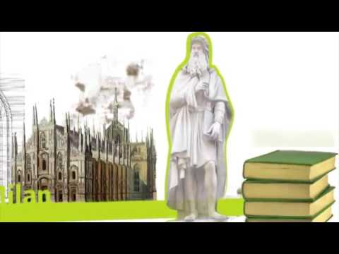
to revise at home
Professor Chiara Villani

Slide 29
UNIT 5
Education sheets and video
Professor Chiara Villani

Slide 30
EDUCATIONAL SHEETS
Donatello
BIOGRAPHY
WORKS
GAME
Professor Chiara Villani

Slide 31
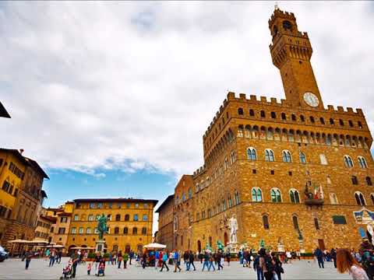
to revise at home
Professor Chiara Villani

Slide 32
EDUCATIONAL SHEETS
michelangelo
BIOGRAPHY
WORKS
GAME
Professor Chiara Villani

Slide 33
to revise at home
Professor Chiara Villani

Slide 34
2.
UNIT 6
Educational sheets and video
Professor Chiara Villani

Slide 35
EDUCATIONAL SHEETS
masaccio
BIOGRAPHY
WORKS
GAME
Professor Chiara Villani

Slide 36
to revise at home
Professor Chiara Villani

Slide 37
EDUCATIONAL SHEETS
botticelli
BIOGRAPHY
WORKS
GAME

Slide 38
to revise at home
Professor Chiara Villani

Slide 39
EDUCATIONAL SHEETS
raffaello
BIOGRAPHY
WORKS
GAME
Professor Chiara Villani

Slide 40
to revise at home
Professor Chiara Villani

Slide 41
2.
UNIT 7
Educational sheets and video
Professor Chiara Villani

Slide 42
EDUCATIONAL SHEETS
leonardo
Sheets with tables and presentation informations
Professor Chiara Villani

Slide 43
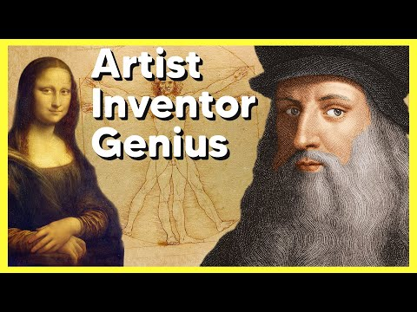
BIOGRAPHY AND WORKS
Part 1
Part 2
Professor Chiara Villani

Slide 44
BIOGRAPHY AND WORKS
Part 3
Part 4
Professor Chiara Villani

Slide 45
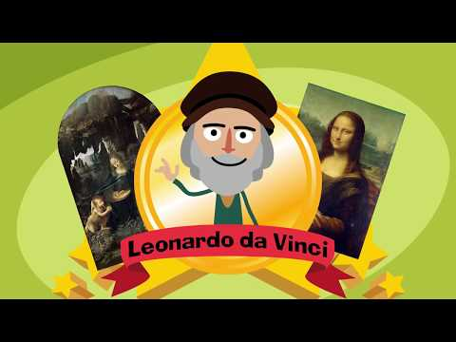
SIMPLE
Professor Chiara Villani

Slide 46
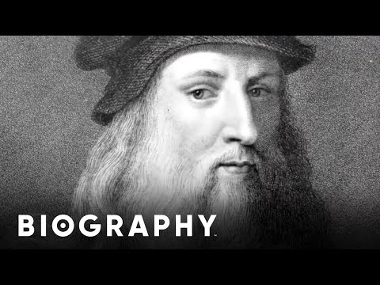
to revise at home
Professor Chiara Villani

Slide 47
UNIT 9
GAMES
Professor Chiara Villani

Slide 48
GAME TO REVISE
Big concepts

Slide 49
BIG CONCEPTS
MAP
CROSSWORD
PUZZLE
Professor Chiara Villani

Slide 50
GAME TO REVISE
Architecture
Professor Chiara Villani

Slide 51
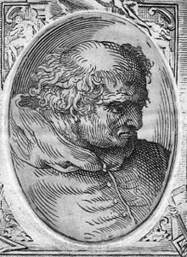
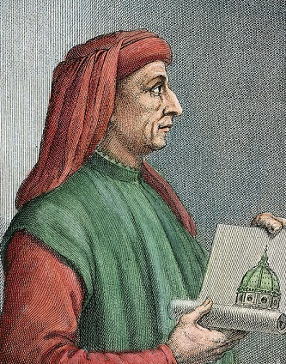
ARCHITECTURE
BRAMANTE OR BRUNELLESCHI
BRAMANTE WORKS AND BIOGRAPHY
BRUNELLESCHI WORKS AND BIOGRAPHY
Professor Chiara Villani

Slide 52
GAME TO REVISE
SCULPTURE
Professor Chiara Villani

Slide 53
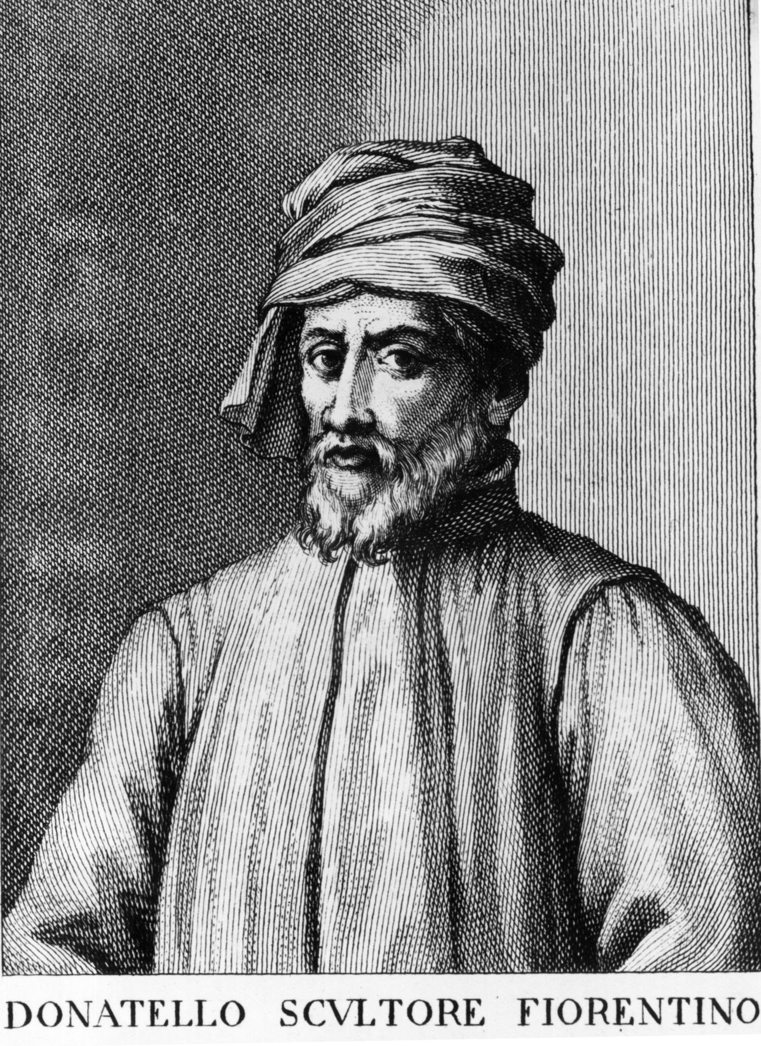
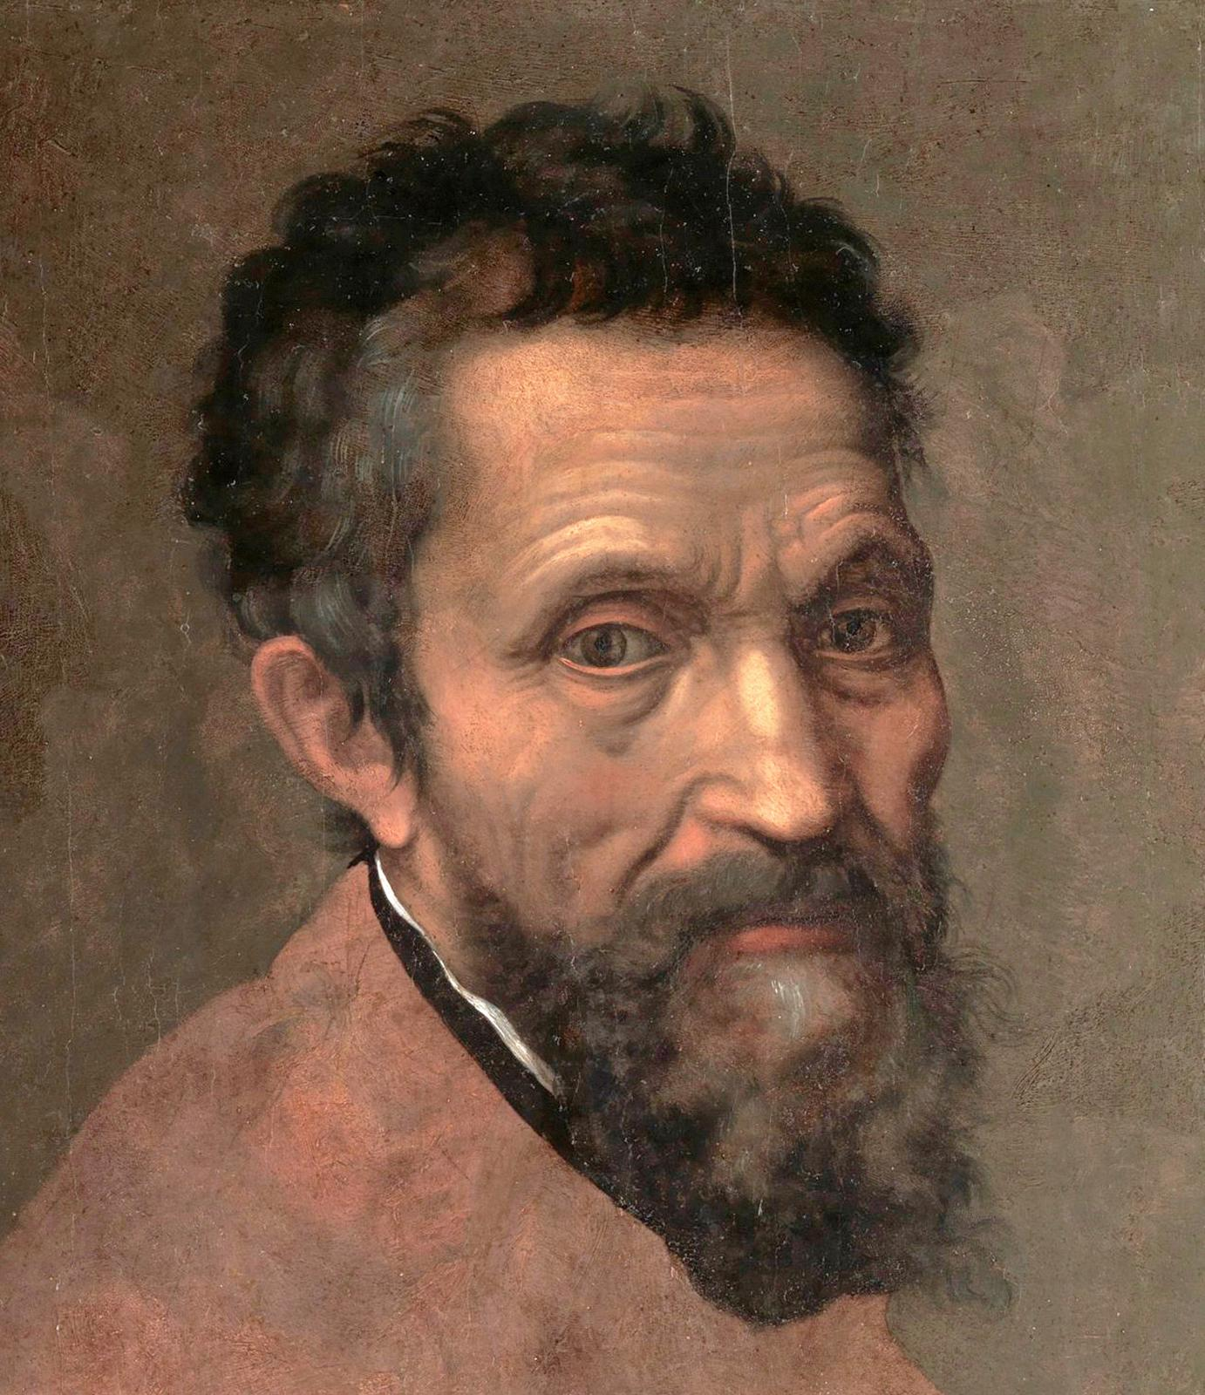
SCULPTURE
DONATELLO OR MICHELANGELO
DONATELLO WORKS AND BIOGRAPHY
MICHELANGELO WORKS AND BIOGRAPHY
Professor Chiara Villani

Slide 54
GAME TO REVISE
PAINT
Professor Chiara Villani

Slide 55
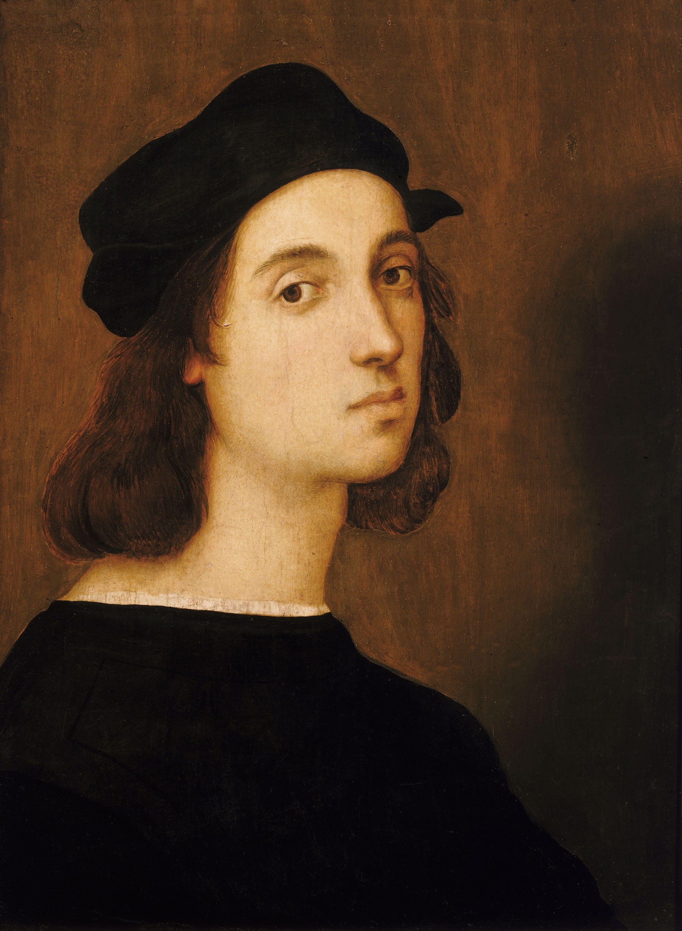
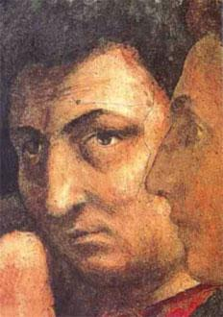
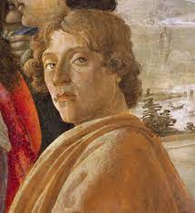
PAINTING
RAFFAELLO, BOTTICELLI OR MASACCIO
MASACCIO WORKS AND BIOGRAPHY
RAFFAELLO WORKS AND BIOGRAPHY
BOTTICELLI WORKS AND BIOGRAPHY
Professor Chiara Villani

Slide 56
KAHOOT
https://kahoot.it/challenge/05100333?challenge-id=856dbcb0-ff58-495e-ba3b-e116a6c7e313_1649004539027
Professor Chiara Villani

Slide 57
UNIT 10
ONLY FOR THE TEACHER
(the teacher doesn’t give this part to the students)
Professor Chiara Villani

Slide 58
DOCUMENTS
FINAL TEST
1
2
EXCEL TABLE TO EVALUATE PRESENTATION
Professor Chiara Villani

