Slide 1
LIVING AND
NON-LIVING THINGS

Slide 2
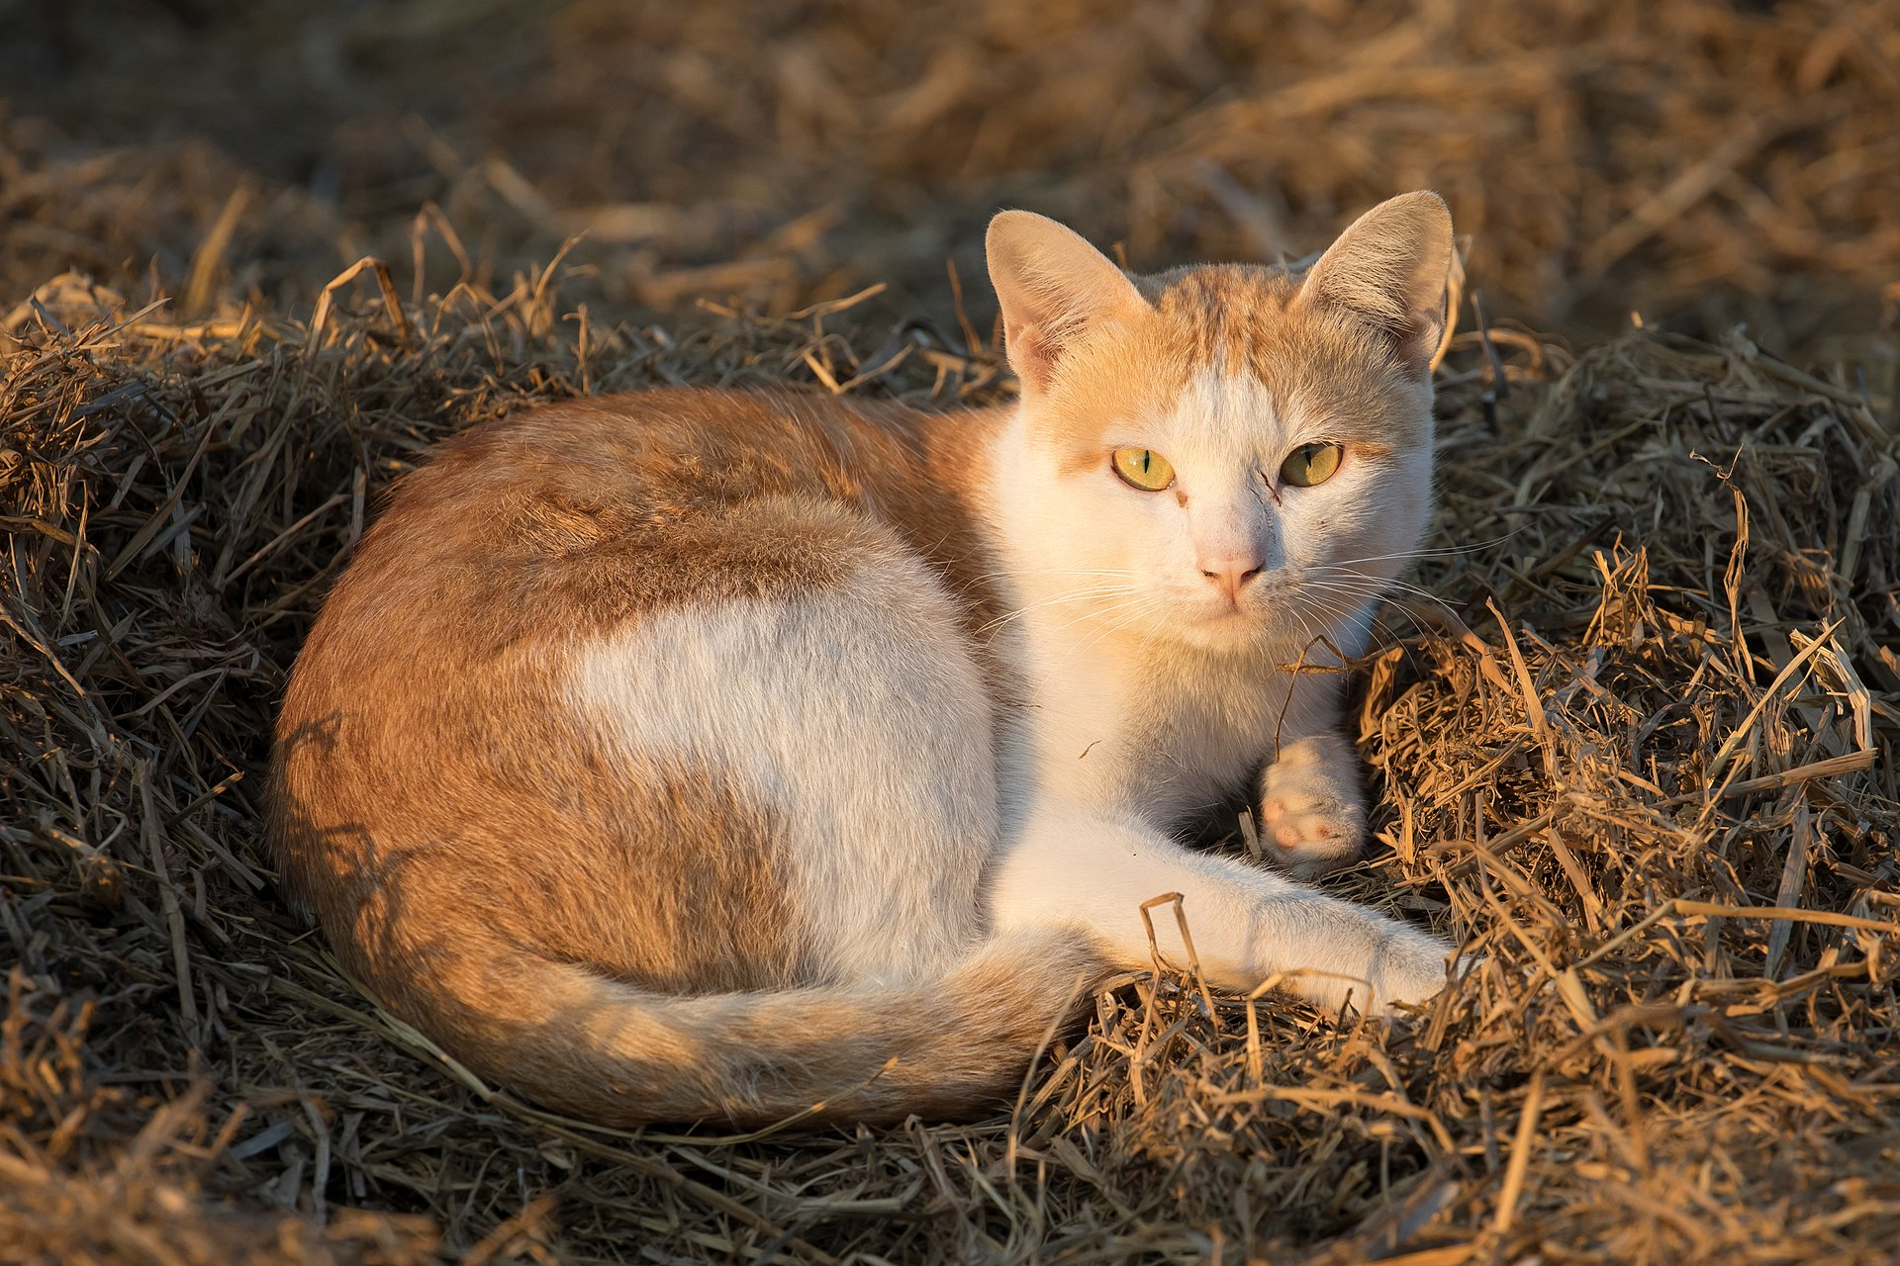
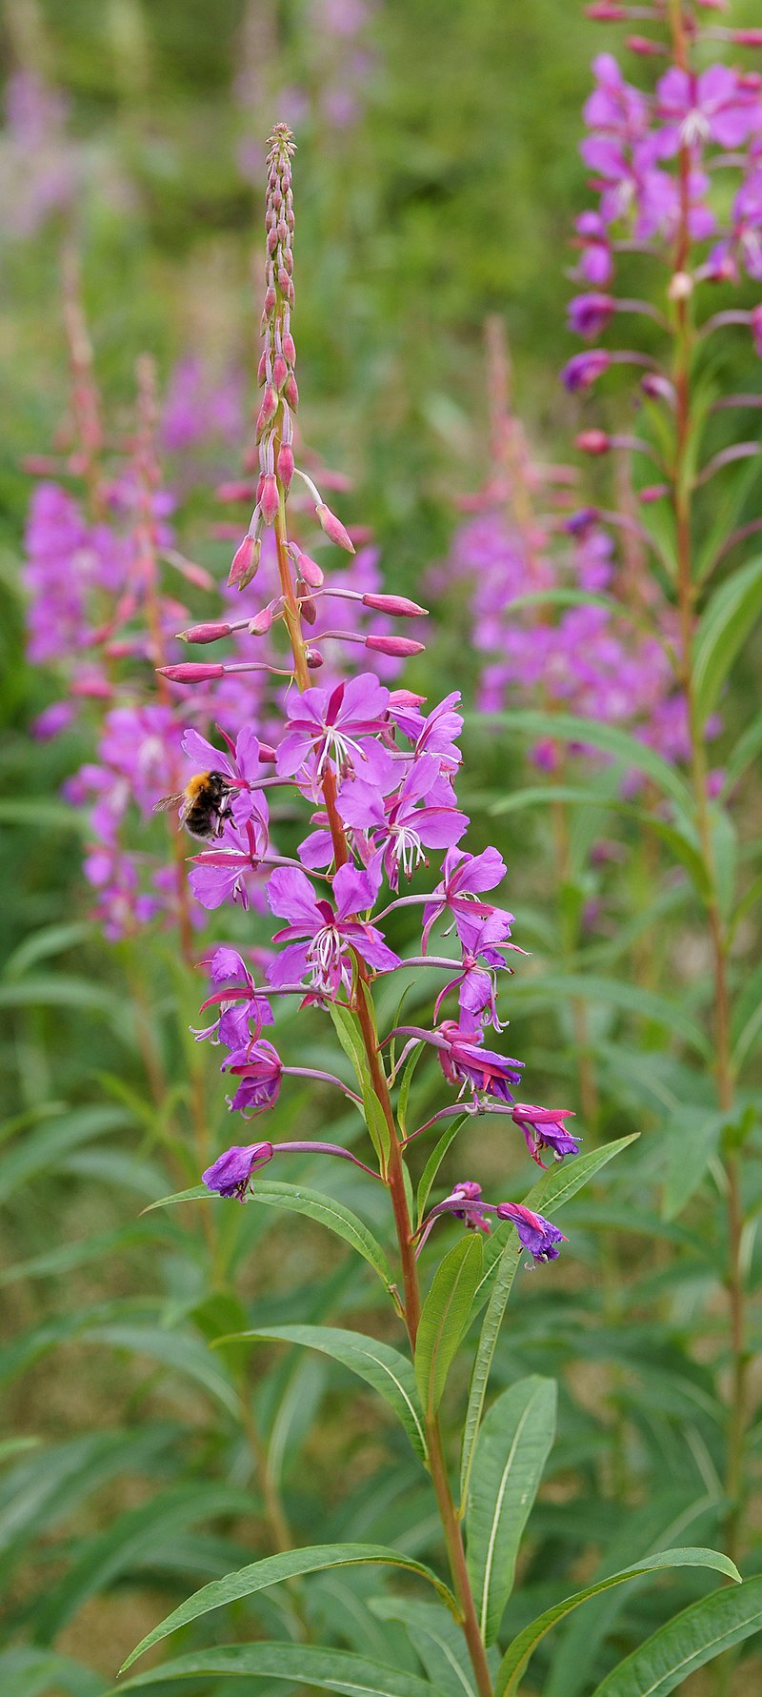
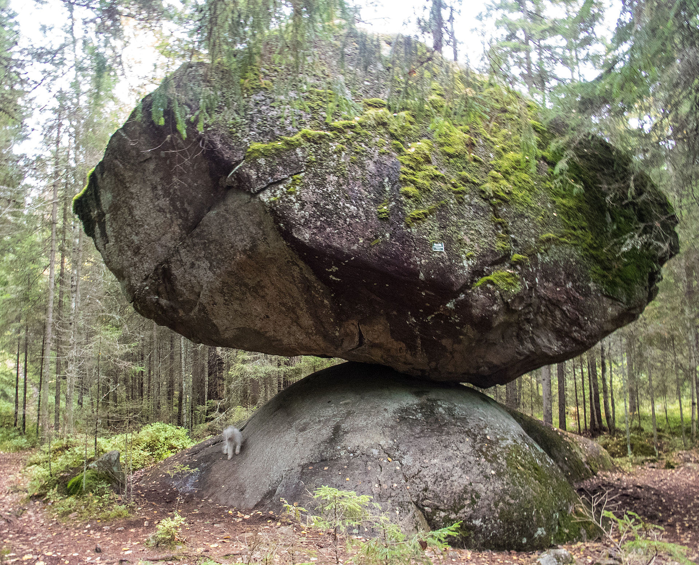
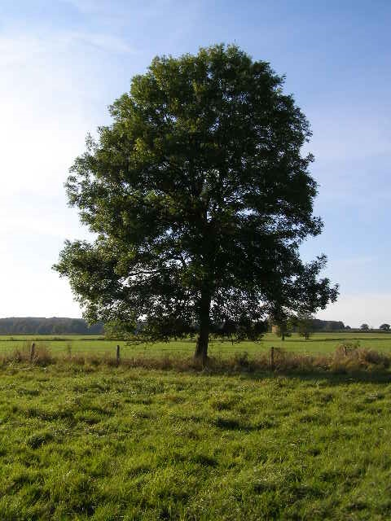
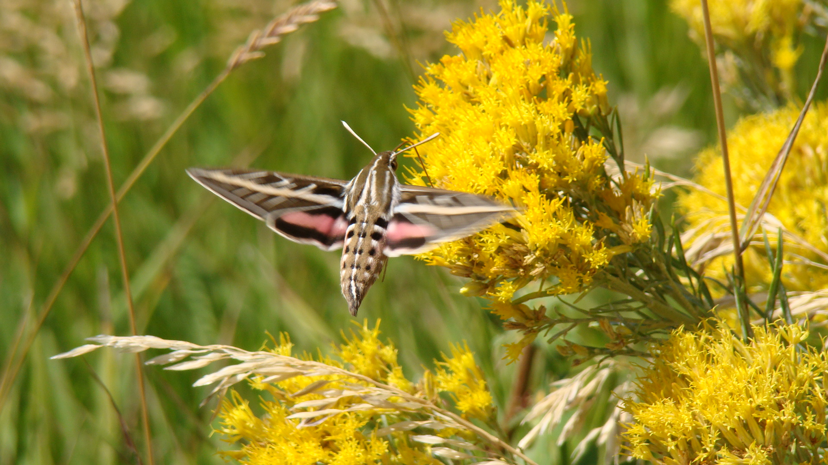
By Basile Morin - Own work, CC BY-SA 4.0, https://commons.wikimedia.org/w/index.php?curid=68508072
By Kotivalo - Own work, CC BY-SA 4.0, https://commons.wikimedia.org/w/index.php?curid=43601822
By kallerna - Own work, CC BY-SA 3.0, https://commons.wikimedia.org/w/index.php?curid=7339651
By J. Pinta (Redline2200) - Own work, CC BY-SA 3.0, https://commons.wikimedia.org/w/index.php?curid=30297568
By Brian Green, CC BY-SA 2.0, https://commons.wikimedia.org/w/index.php?curid=13127021

Slide 3
CHARACTERISTICS OF THE LIVING THINGS
MOVEMENT
RESPIRATION
GROWTH
REPRODUCTION
NUTRITION
EXCRETION

