Slide 1
Classical music is born in America
True
False

Slide 2
FALSE

Slide 3
Classical music has
an oral tradition
True
False

Slide 4
FALSE

Slide 5
Classical music is oft played in churches and concert hall
True
False

Slide 6
TRUE

Slide 7
Classical music has got lyrics
True
False

Slide 8
FALSE

Slide 9
Classical music is composed from 1600 to 1900
True
False

Slide 10
TRUE

Slide 11
Classical music includes long compositions
True
False

Slide 12
TRUE

Slide 13
Classical music has got lyrics
True
False

Slide 14
FALSE

Slide 15
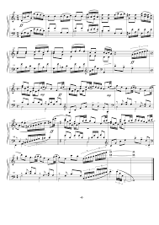
This is a musical score
True
False

Slide 16
TRUE

